Slide 1
Team Documents to Plan for success
Raya Burch

Slide 2
Overview
Agendas
Gantt Charts
Work Logs
Minutes

Slide 3
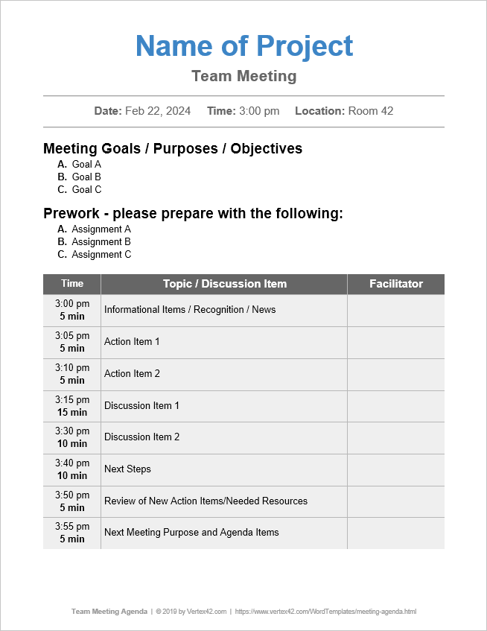
Agendas
Outlines meeting objectives
Archive of past meetings
Keeps team members engaged
Helps team members prepare for the meeting
https://www.vertex42.com/WordTemplates/meeting-agenda.html

Slide 4
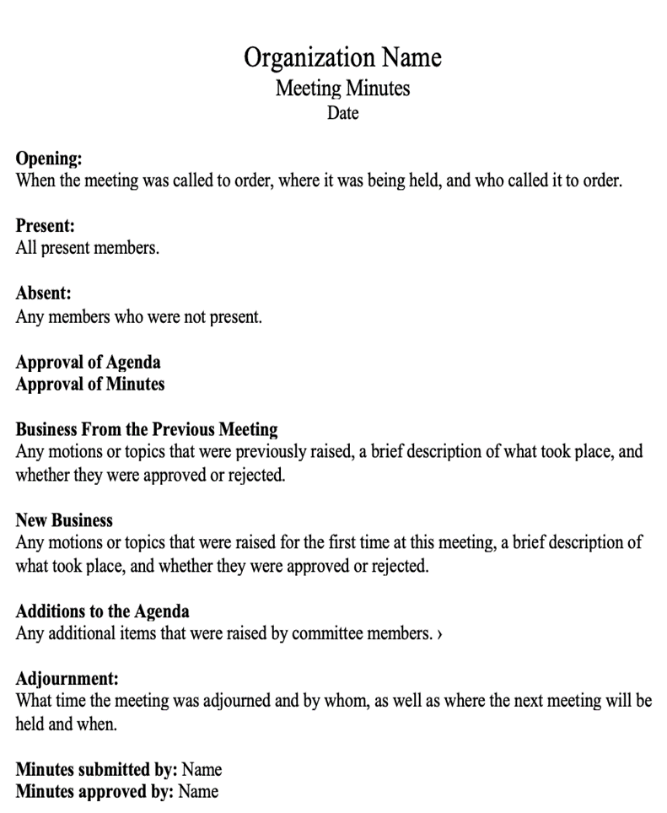
Minutes
Provides notes about decisions made and topics discussed
Records progress of project tasks
Keeps members accountable
Informs absent members of meeting details
https://www.wildapricot.com/blog/how-to-write-meeting-minutes#meeting-minutes-template

Slide 5
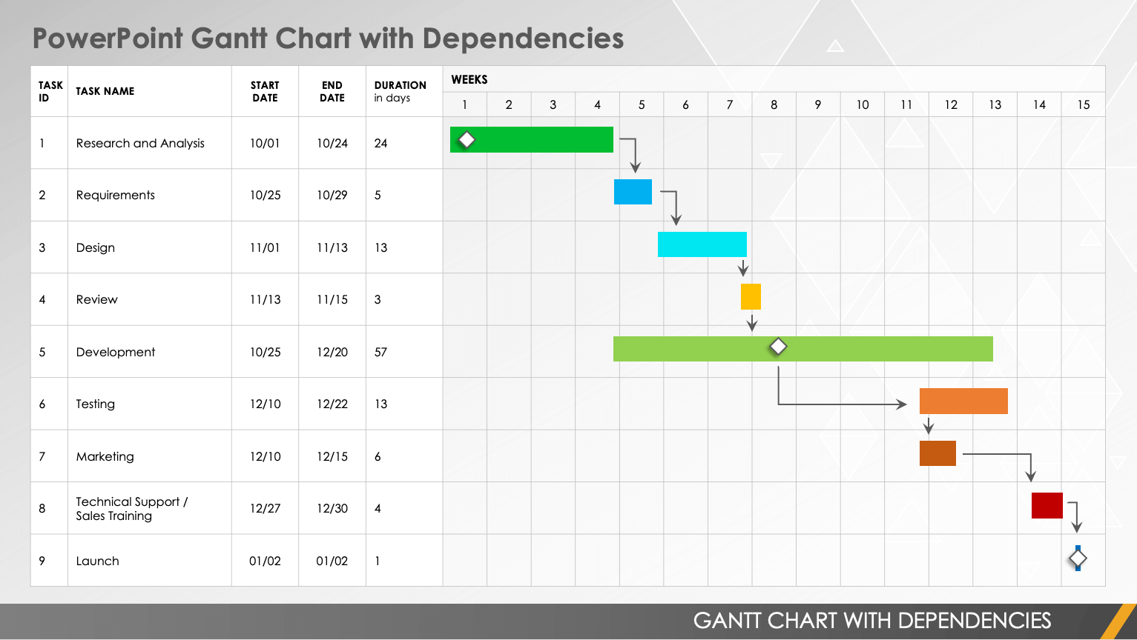
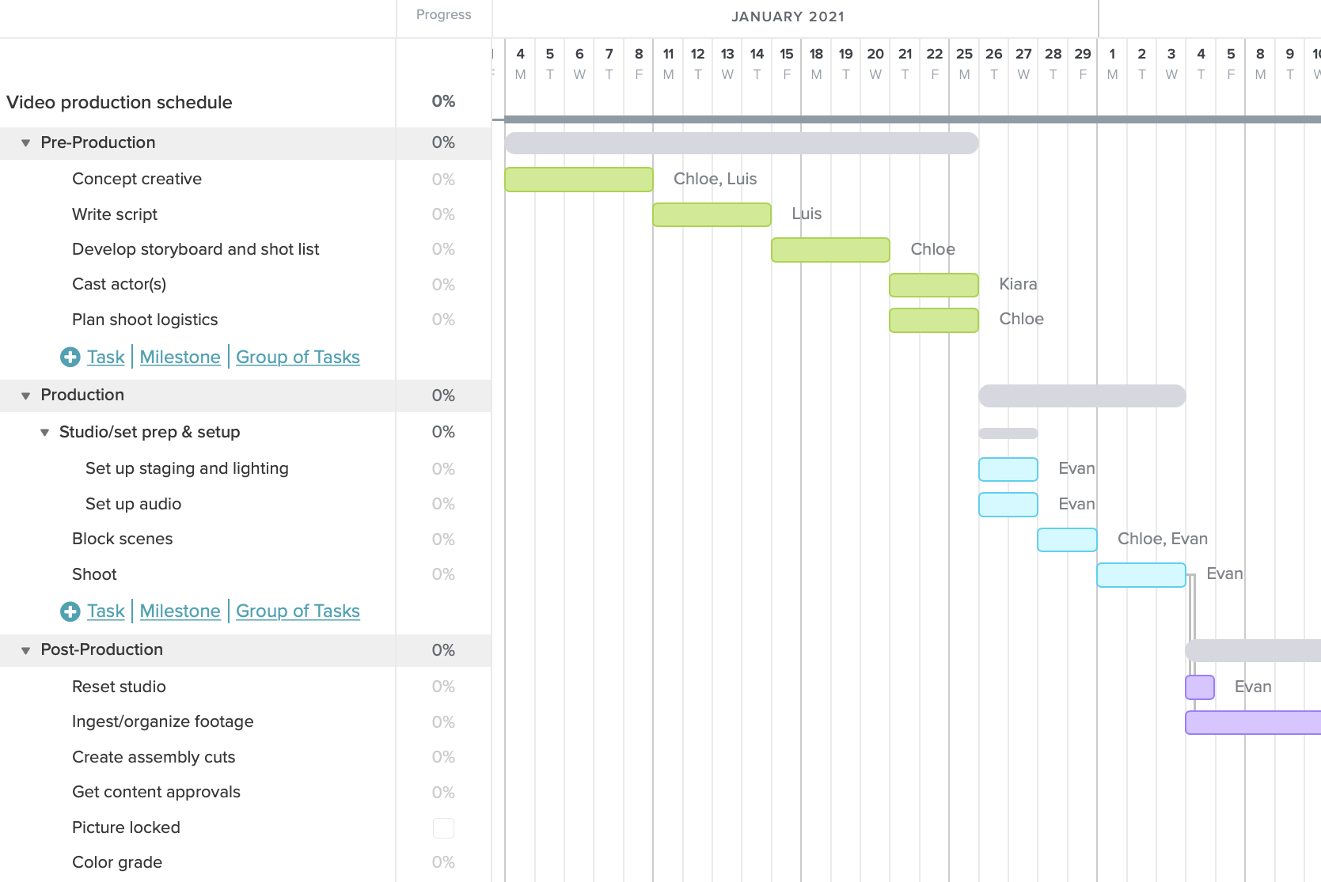
Gantt charts
Detailed project work schedules
Long term project plan
Shows task dependencies
Helps identify resources needed and possible obstacles
https://www.smartsheet.com/content/gantt-chart-templates-dependencies
https://www.teamgantt.com/blog/gantt-chart-example

Slide 6
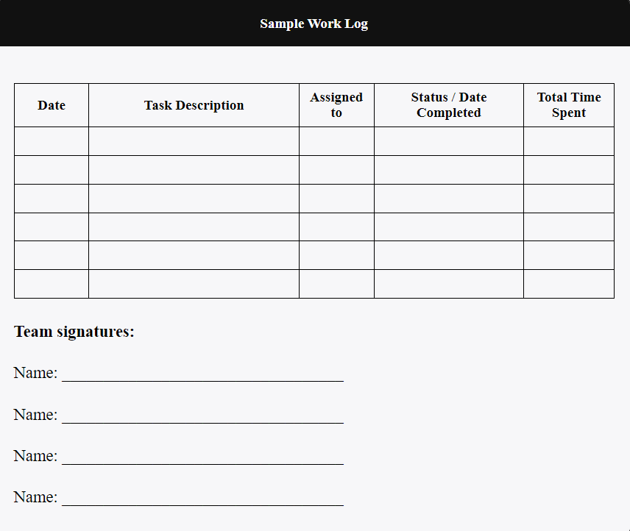
Work Logs
Communicate task progress and completion
Show spread of workload
Show individual and group productivity
https://pressbooks.bccampus.ca/technicalwriting/chapter/teampmtools/

Slide 7
Why planning documents are important
Provide clear project goals
Encourage healthy communication
Helps prevent conflict among members
Holds team members accountable
Will use similar documents in an engineering career

Slide 8
Summary
Agendas
Gantt Chart
Minutes
Work Logs

Slide 9
References
[1] S. Last, “Team Project Management Tools and Strategies,” in Technical Writing Essentials: Introduction to Professional Communications in the Technical Fields, 2019. [Online]. Available:
https://pressbooks.bccampus.ca/technicalwriting/chapter/writingpersuade/.
[Accessed: Feb. 10, 2023. ]
[2] “Why Are Agendas So Important?,” Docket [Online]. Available:
https://www.dockethq.com/resources/why-are-agendas-so-important/#:~:text=Agendas%20are%20a%20crucial%20component,stay%20engaged%20and%20follow%20along
[Accessed: Feb. 10, 2023. ]
[3] “The Importance Of Taking Meeting Minutes,” Geneva Business News [Online]. Available:
https://www.gbnews.ch/the-importance-of-taking-meeting-minutes/#:~:text=The%20minutes%20say%20who%20will,know%20what%20agreements%20were%20made
[Accessed: Feb. 11, 2023. ]
[4] “Gantt Charts,” Mind Tools [Online]. Available:
https://www.mindtools.com/aktsij3/gantt-charts
[Accessed: Feb. 11, 2023. ]
[5] “Time Logs in Workplace,” Papershift [Online]. Available:
https://www.papershift.com/en/lexicon/time-logs-in-workplace
[Accessed: Feb. 11, 2023. ]

